Slide 1
AlphaFold2
(And OpenFold)
Structure Prediction
Ian Anderson
Adapted from Nick Randolph’s 2024 Bootcamp

Slide 2
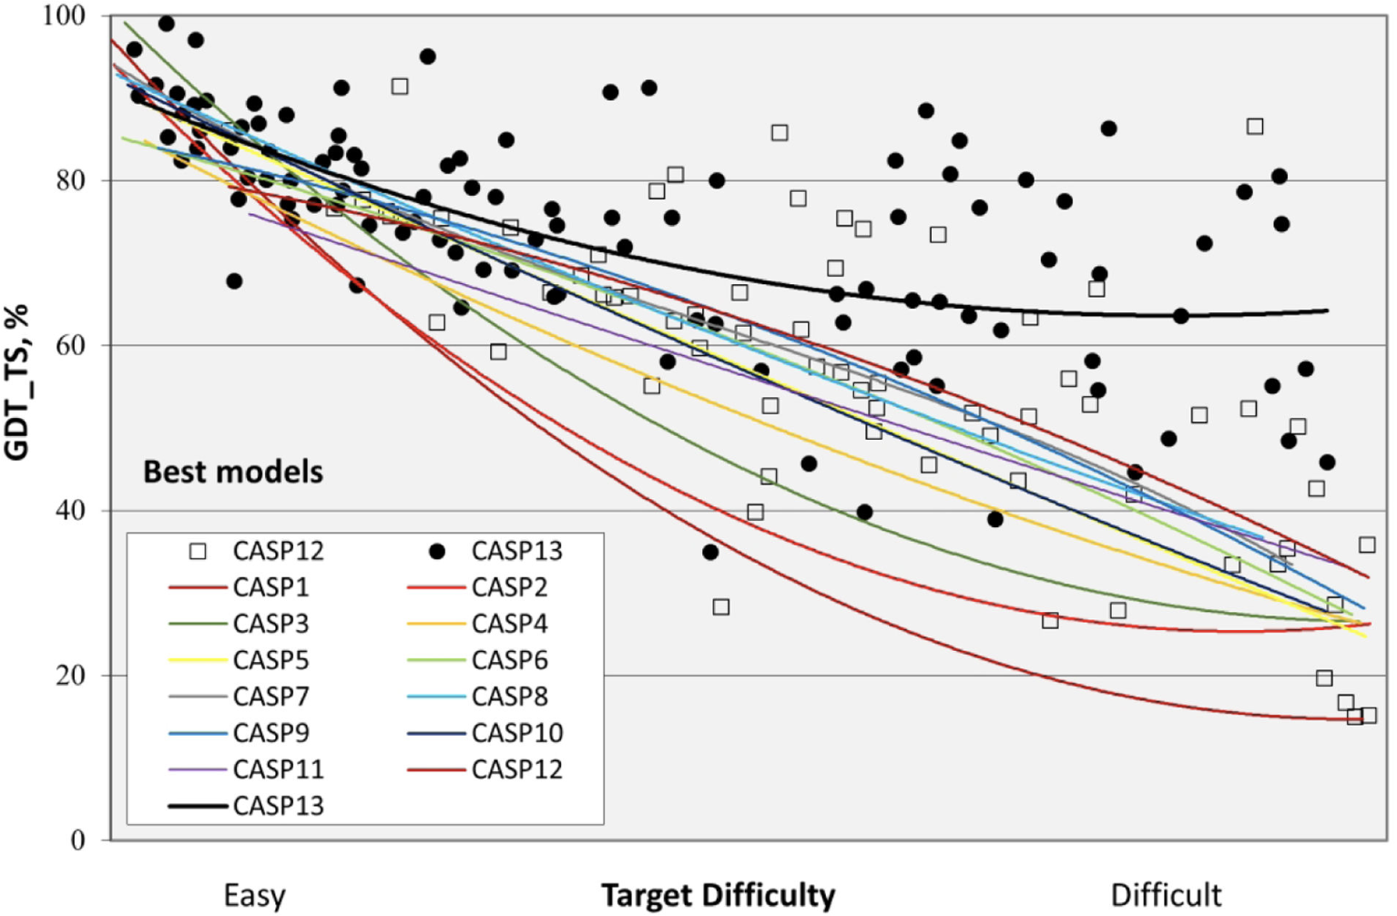
Introducing AlphaFold2…
2018: 14th Critical Assessment of Protein Structure Prediction (CASP14)

Slide 3
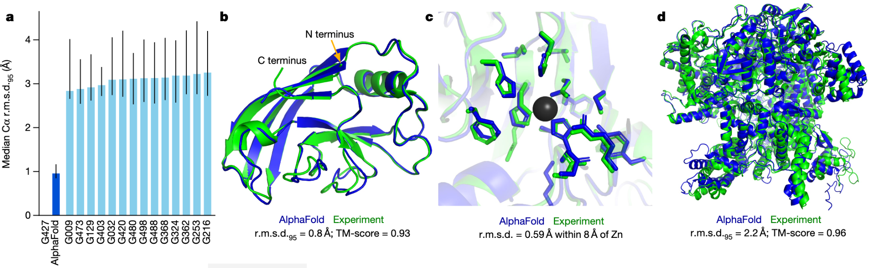
Introducing AlphaFold2…
2018: 14th Critical Assessment of Protein Structure Prediction (CASP14)
Jumper et al. (2021)

Slide 4
Introducing AlphaFold2…
2018: 14th Critical Assessment of Protein Structure Prediction (CASP14)
Jumper et al. (2021)

Slide 5
AlphaFold2 vs OpenFold
Faithful but trainable reproduction of AlphaFold2
Major differences:
OpenFold runs between three and five times faster for most proteins
OpenFold it uses less memory, allowing prediction of extremely long proteins and multi-protein complexes on a single graphics processing unit (GPU)
OpenFold is implemented in PyTorch, the most widely used machine learning framework; AlphaFold2 uses JAX.
Ahdritz et al. (2024)

Slide 6
Overview

Slide 7
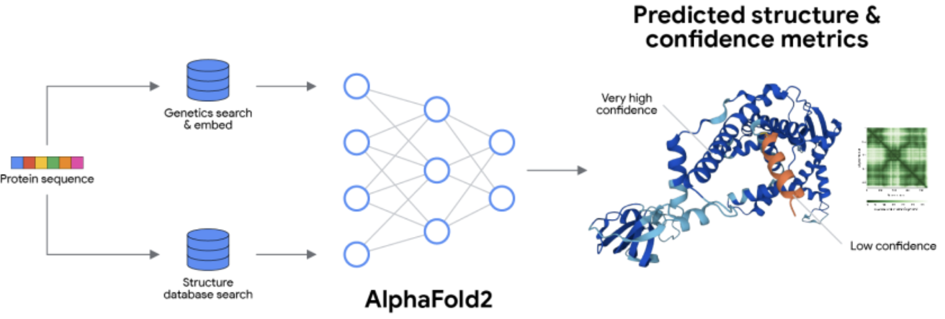
Inputs and Outputs

Slide 8
Under the Hood

Slide 9
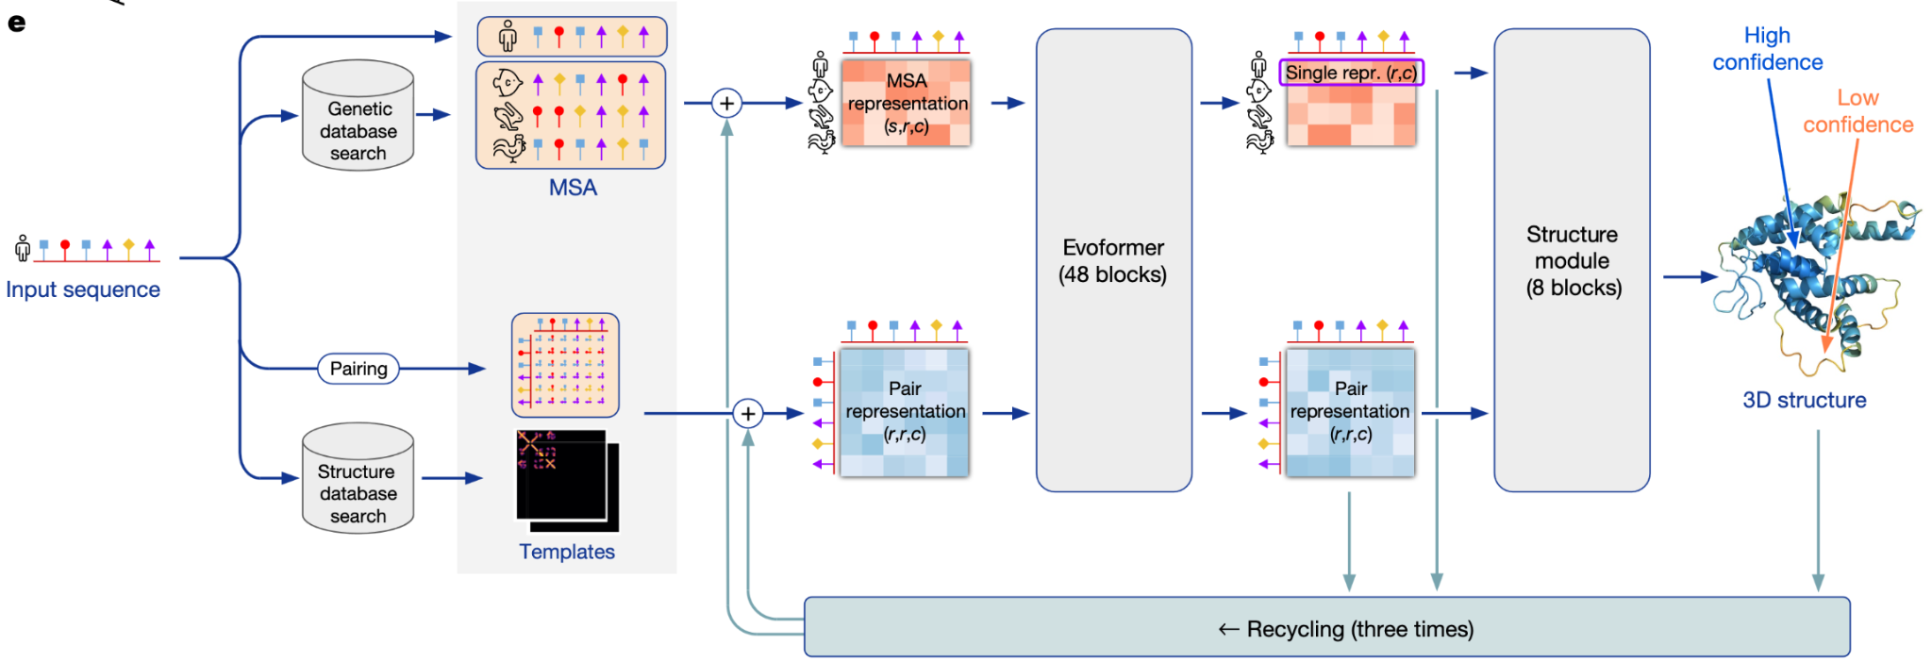
AlphaFold2 Overview
Jumper et al. (2021)

Slide 10
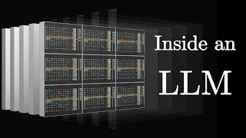
Notes:
https://www.youtube.com/watch?v=P_fHJIYENdI

Slide 11
AlphaFold2 Overview
Jumper et al. (2021)
Notes:
Extract evolutionary constraints from MSAs
Construct a learned pairwise geometry field
Iteratively reason about constraints via attention and triangle relations
Convert constraints into 3D coordinates with an SE(3)-aware geometric module
Recycle predictions to self-correct

Slide 12
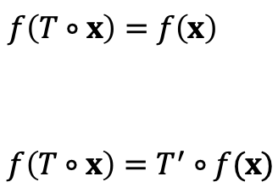
SE(3) Symmetries
If you rotate or translate a protein,
it's the same protein, so the fact that it is a protein is invariant to global rigid transformations.
the coordinates are now in a different location but one that depends on the rotation and translation. So we say the coordinates are equivariant to global rigid transformations.
Invariance:
Equivariance:

Slide 13
Extensions

Slide 14
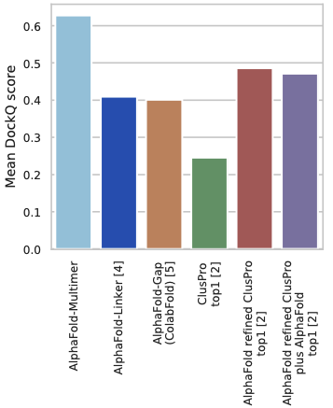
AlphaFold2-Multimer
Losses to take into account permutation symmetry among identical chains
Pair the MSA alignments between individual chains for cross-chain genetic information
New way of selecting subsets of residues for training
Various small adjustments to the structure losses and the model architecture
Evans et al. (2021)

Slide 15
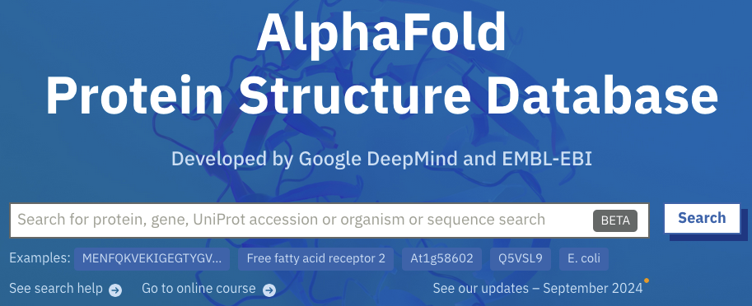
AlphaFoldDB
The latest database release contains over 200 million entries, providing broad coverage of UniProt (the standard repository of protein sequences and annotations).
Includes entire human proteome and the proteomes of 47 other key organisms
Varadi et al. (2022)

Slide 16
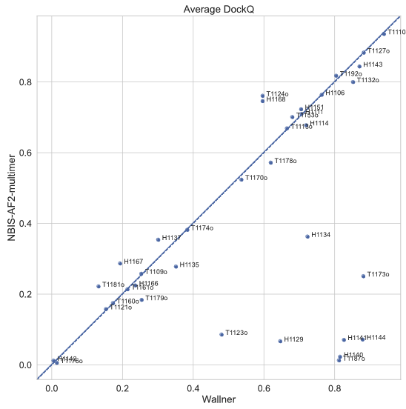
AFsample
Large-scale prediction of AF2-Multimer with the settings:
EvoFormer dropout enabled
More recycling
Wallner (2022)

Slide 17

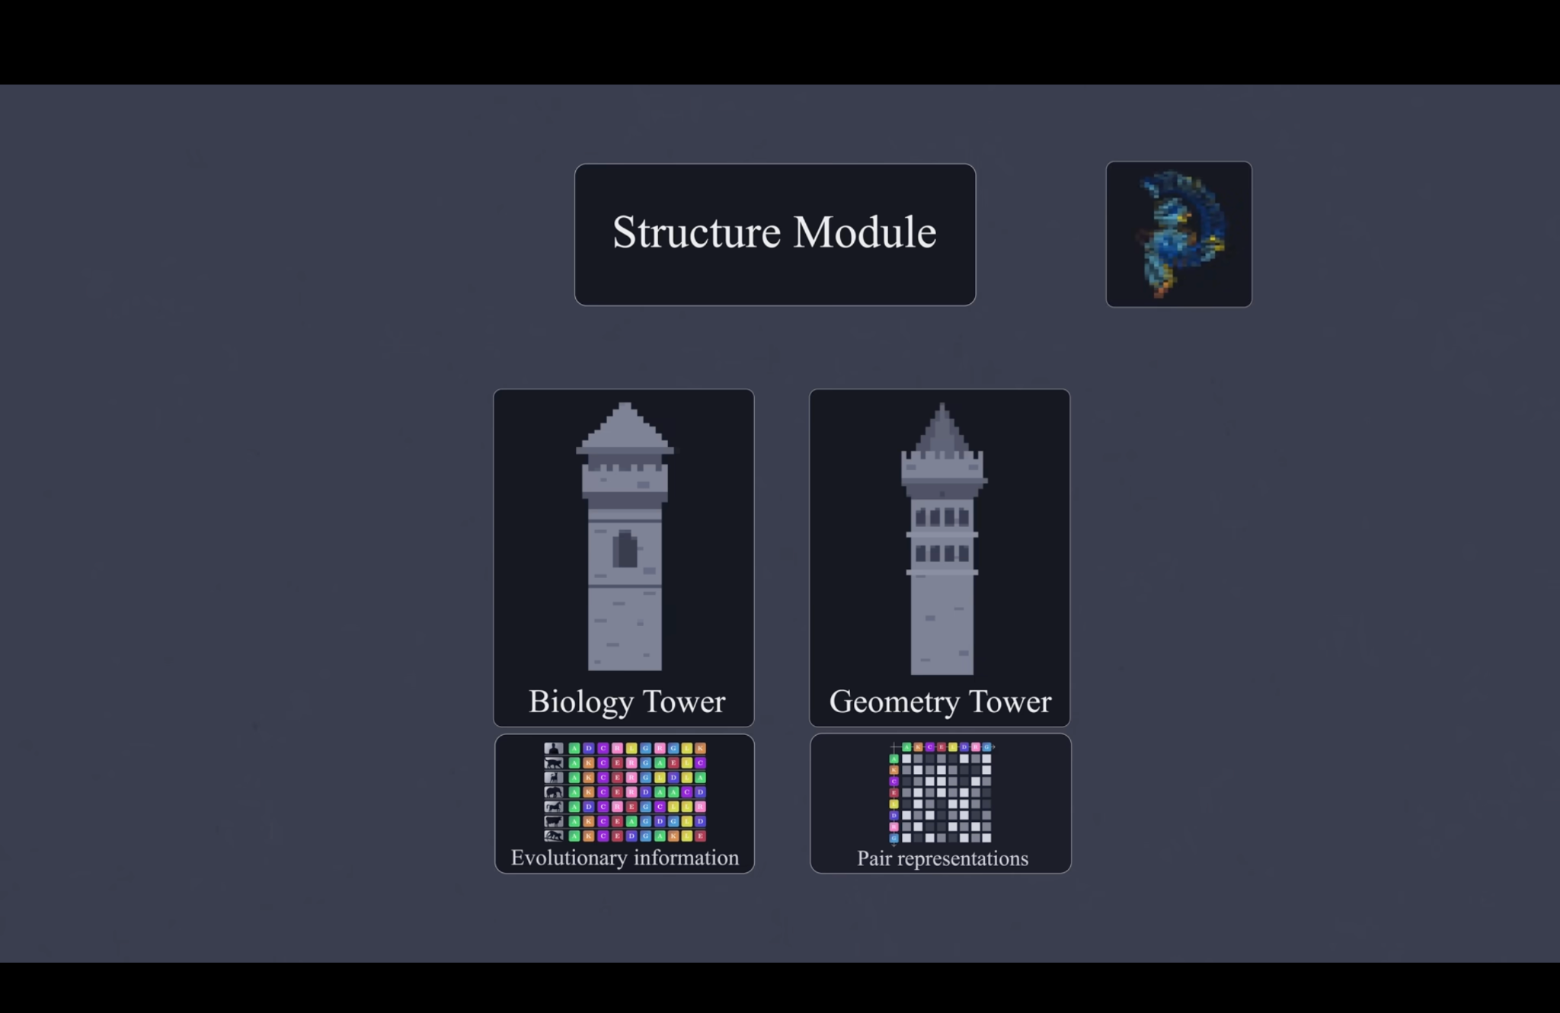

AF2 Initial Guess (Baker Lab)
https://www.nature.com/articles/s41467-023-38328-5

Slide 18
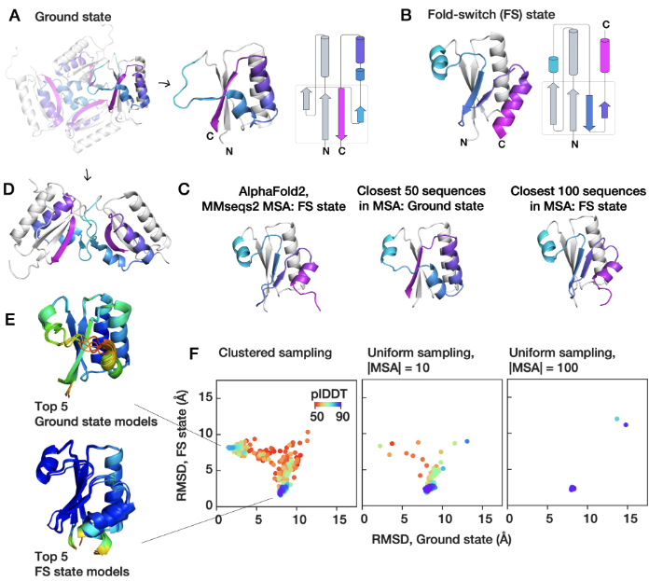
AF-Cluster
Clustering the MSA can bias AF2 towards different states
Wayment-Steele et al. (2022)

Slide 19
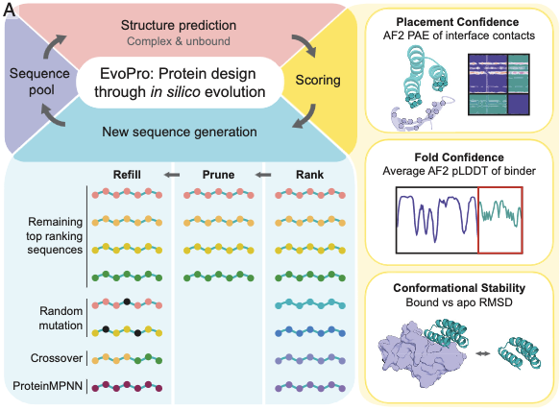
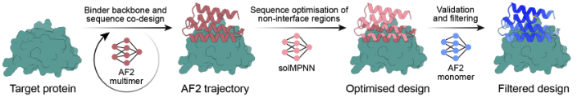
Automated AF2 workflows
EvoPro
BindCraft
Goudy et al. (2023)
Pacesa et al. (2024)

Slide 20
Alphafold2 Parameters

Slide 21
Recycling / Model Confidence
Parameter | What it does
num_recycles | How many times the model refines the structure. 0–20+ typical. Higher → better but slower.
max_recycles | Hard cap for recycling.
recycle_early_stop_tolerance | Stops early if the structure converges.
tol (older versions) | Another early-stop threshold parameter.

Slide 22
MSA Settings
Parameter | Explanation
msa_mode | MMseqs2 (default), single_sequence, jackhmmer, mmseqs2_uniref, etc.
pair_mode | For multimers: paired, unpaired, paired+unpaired, unpaired+paired (affects inter-chain contacts heavily).
use_msa | Boolean to disable MSA entirely (single-sequence mode).
use_env | Include environmental MSA (metagenomic hits).
use_templates | Whether to search for templates.

Slide 23
Model controls
Parameter | What it does
model_type | monomer, monomer_ptm, multimer, multimer_v3 (in newer builds).
num_models | Typically 5 AF2 models. Picking fewer is faster.
rank_by | Ranking metric: pTMscore, iptm+ptm, plddt.
use_dropout | Enable dropout (useful for sampling structural diversity).
use_fast_relax | Enable Amber relax (slow but improves geometry).
use_gpu_relax | GPU Amber relaxation.

Slide 24
Hands-On Activity

